Slide 1
Capstone Project ideas
DSIR 1010 - Preet Sekhon

Slide 2

Areas of Interest

Slide 3
Areas of Interest
Soccer (Football) Betting
Accuracy of xG (Expected Goals) by League
Real Estate
Correlation between Climate Change and Real Estate Land Purchase Trends
Identifying Future High Value Markets

Slide 4
Soccer (Football) Betting
Notes:
Sports betting is here to stay. What once was taboo, is now common place

Slide 5
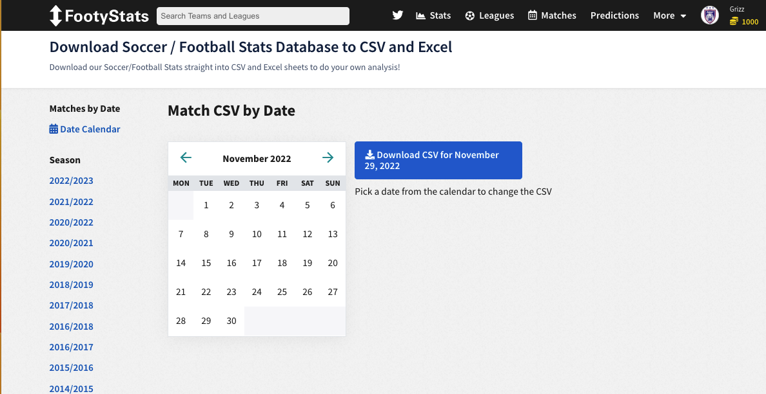
Soccer (Football) Betting
Current Sources:
Footystats.org
Notes:
- Which leagues?
- Which day of the week?
- When in the season?
- The team's table position?

Slide 6
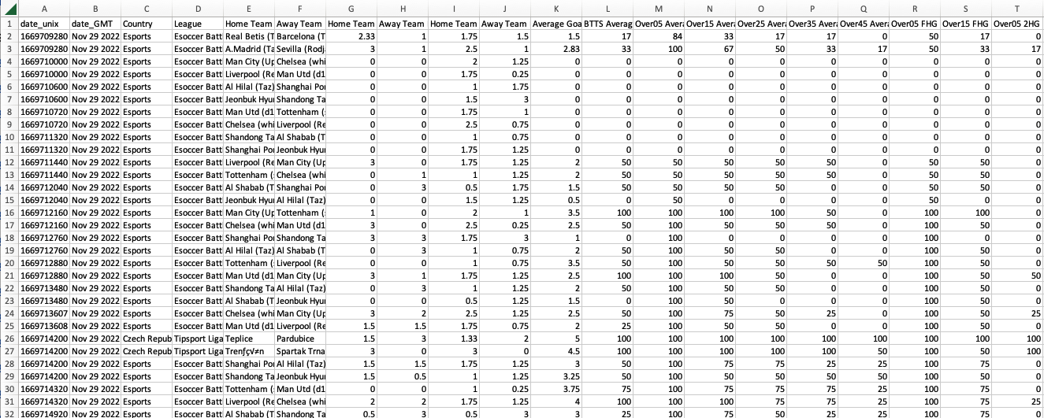
Soccer (Football) Betting
Current Sources:
Footystats.org
11.29.22.csv.shape
288, 107

Slide 7
Soccer (Football) Betting
Kaggle.com
In-depth Soccer Statistics: xG, xA and More
Football Data: Expected Goals and Other Metrics

Slide 8
Soccer (Football) Betting
Audience
Gamblers
Sports Watchers

Slide 9
Soccer (Football) Betting
Obstacles
Betting Sites might not like being Scraped
Merging and Updating of Datasets
Training set is forever growing
Need to find a Dataset that shows betting market data

Slide 10
Real Estate - Climate Change and Real Estate Land Purchasing Trends - Identifying Future High Value Markets

Slide 11
RE: Climate Change and Real Estate Land Purchasing Trends
Current Source
Applying Machine Learning to Assess Florida’s Climate-Driven Real Estate Risk
Another Property Database Adds Climate Change Risk to its Analysis
Redfin Data Center – New Construction and Investor Data
Notes:
- Looking for climate change datasets
- Looking for real estate land sales

Slide 12
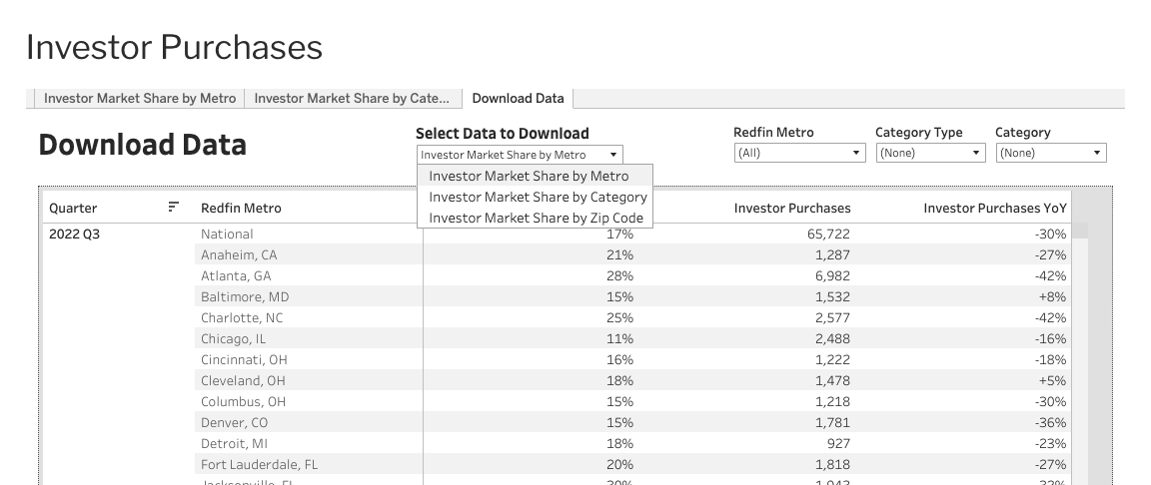
RE: Climate Change and Real Estate Land Purchasing Trends

Slide 13
RE: Identifying Future High Value Markets
Data.World
Home Construction Price Index
Need
I want to get construction cost data by city/county/state
I want to get real estate sales data by city/county/state

Slide 14
Real Estate
Audience
Individual Investors
REITs
Hedge Funds

Slide 15
Real Estates
Obstacles
Merging and Updating of Datasets

Slide 16
Thank you Questions & Comments?

